Slide 1


Analysis of the connectivity of hydrides within the microstructure of Zr alloys
Research Software Engineering Practice
Group 2
Wunmi Olukoya, Jamie McGregor, Enn Veikesaar and Laura González Duque
03/06/2021
Notes:
Good morning, I’m Laura Gonzalez and I’m going to present the progress of my mini-project, called “The effect of texture on the stress and strain localisation during aluminium sheets bending”, which is being supervised by Joseph Robson and Joao Fonseca

Slide 2
Motivation of the project
Context
Objectives
1
Notes:
Aluminium alloys are among the most worldwide demanded alloys and their demand grows every year because they count on many advantageous characteristics, being the principal their low density and low price, especially of interest in the vehicle sector. The European Aluminium association estimated a 40% growth in demand for aluminium between 2019 and 2050. Aluminium sheets are the most popular way of use of this material and they are widely employed in many relevant sectors because they can be cut and formed into different desired shapes. Therefore, there is a strong incentive to optimise the performance of this product and competition in the market is very strong.

Slide 3
Packaging & documentation
Image loading
Image processing
Thresholding
Connectivity
1
Notes:
Aluminium alloys are among the most worldwide demanded alloys and their demand grows every year because they count on many advantageous characteristics, being the principal their low density and low price, especially of interest in the vehicle sector. The European Aluminium association estimated a 40% growth in demand for aluminium between 2019 and 2050. Aluminium sheets are the most popular way of use of this material and they are widely employed in many relevant sectors because they can be cut and formed into different desired shapes. Therefore, there is a strong incentive to optimise the performance of this product and competition in the market is very strong.

Slide 4
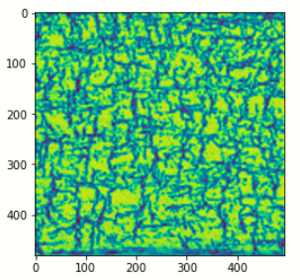
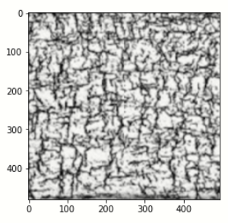
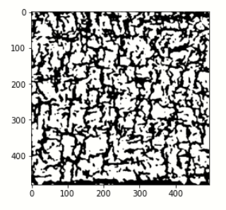
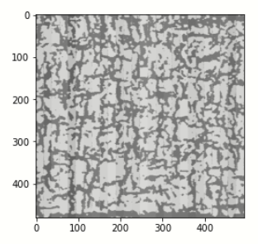
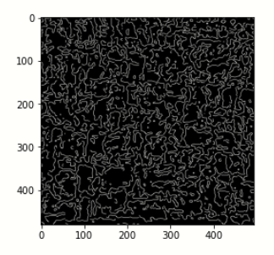
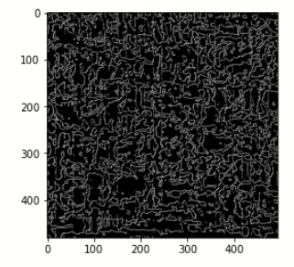
Results
Loading
Processing
Thresholding
Connectivity
Otsu
K-means
Otsu
K-means
1
Notes:
Aluminium alloys are among the most worldwide demanded alloys and their demand grows every year because they count on many advantageous characteristics, being the principal their low density and low price, especially of interest in the vehicle sector. The European Aluminium association estimated a 40% growth in demand for aluminium between 2019 and 2050. Aluminium sheets are the most popular way of use of this material and they are widely employed in many relevant sectors because they can be cut and formed into different desired shapes. Therefore, there is a strong incentive to optimise the performance of this product and competition in the market is very strong.

Slide 5
Testing
1
Notes:
Aluminium alloys are among the most worldwide demanded alloys and their demand grows every year because they count on many advantageous characteristics, being the principal their low density and low price, especially of interest in the vehicle sector. The European Aluminium association estimated a 40% growth in demand for aluminium between 2019 and 2050. Aluminium sheets are the most popular way of use of this material and they are widely employed in many relevant sectors because they can be cut and formed into different desired shapes. Therefore, there is a strong incentive to optimise the performance of this product and competition in the market is very strong.

